Slide 1
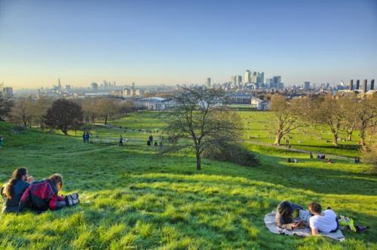

Where Can I Go? What Can I Do?
By Deborah Lesher and Ruth McKee
Columbia Regional Program

Slide 2
I want to go somewhere.

Slide 3

But, things are different now.

Slide 4
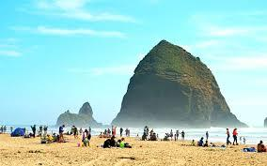
I want to go to the beach.

Slide 5
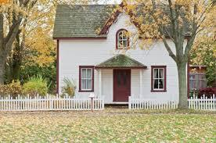
But for now, I'm going to stay home to be safe.

Slide 6
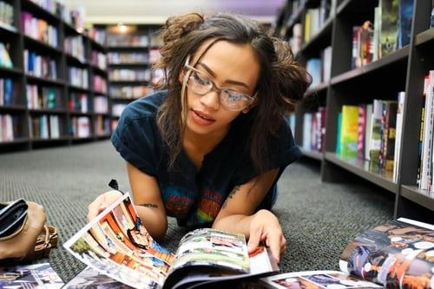
I want to go to the bookstore.

Slide 7
But for now, I'm going to stay home to be safe.

Slide 8
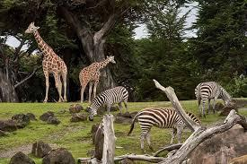
I want to go to the zoo.

Slide 9
But for now, I'm going to stay home to be safe.

Slide 10
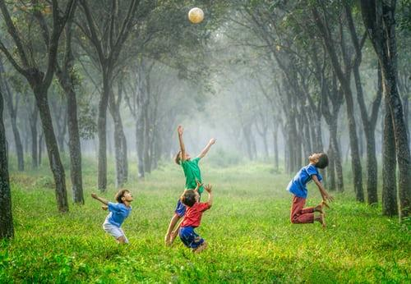
I want to go see my friends.

Slide 11
But for now, I'm going to stay home to be safe.

Slide 12
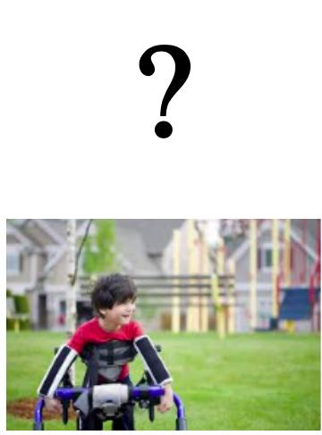
Where can I go? What can I do?

Slide 13
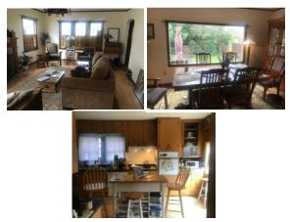
I can go to all the rooms in my house.

Slide 14
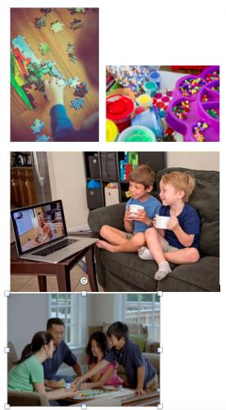
I can do puzzles, play games, make crafts, and meet with my friends on the computer.

Slide 15
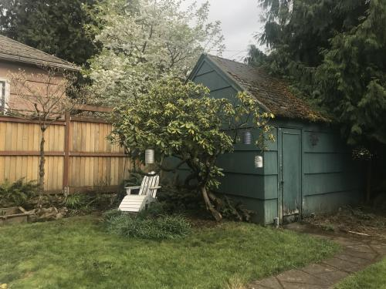
I can go in the backyard.

Slide 16
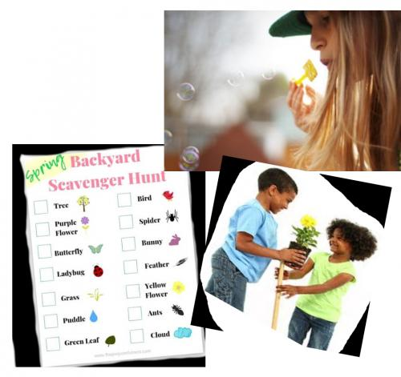
I can do a scavenger hunt, blow bubbles, and plant a garden.

Slide 17
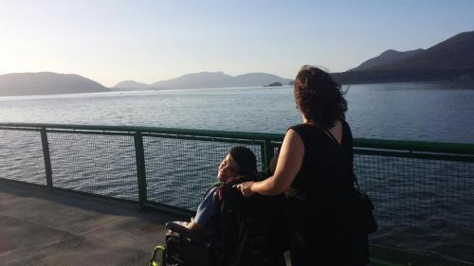
I can go outside for a walk.

Slide 18
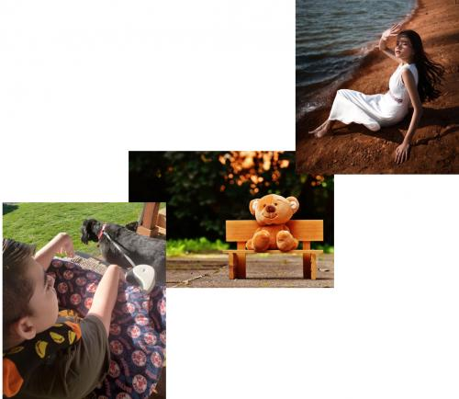
I can walk the dog, go on a bear hunt, and wave to neighbors.

Slide 19
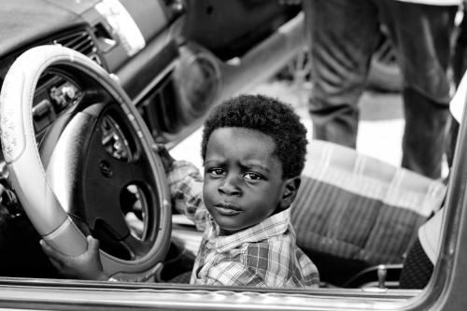
I can go on a drive.

Slide 20
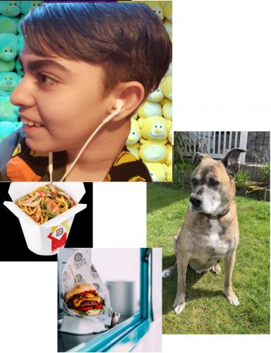
I can listen to music, look for dogs, and pick up take out food.

Slide 21
For now, the places I can go are different.

Slide 22
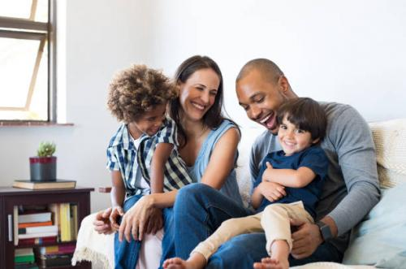
But I can still be safe with my family and do lots of fun things.

